Slide 1
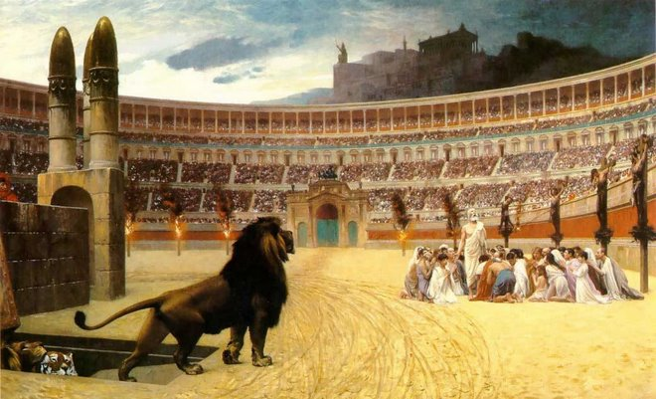
Persecution
Many people around the world suffer from persecution.
In Rome, people were fed to hungry lions for their beliefs.
Forms of Persecution: In America, social persecution would happen

